Slide 2
Local Skills Improvement Plan
November 2022

Slide 3
Local Skills Report
2021
2022
Notes:
Report and a process

Slide 4
Local Skills Improvement Plan (LSIP)
Skills for jobs white paper - government’s blueprint for reshaping the technical skills system to better meet the needs of employers
Introduced local skills improvement plans (LSIPs)
LSIPs will provide an agreed set of actionable priorities that employers, providers and stakeholders in a local area can get behind to drive change.
LSIPs will:
place employers at the heart of local skills systems
facilitate dynamic working arrangements between employers and providers
BBF designated Employer Representative Body to develop the LSIP for Buckinghamshire
Project plan submitted to DfE 3rd October 2022 – now approved
LSIPs to be submitted to Sec of State by 31st May 2023

Slide 5
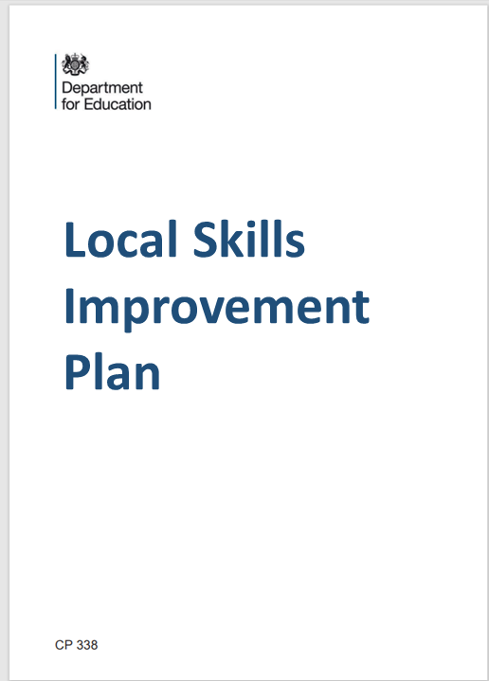
Key points about LSIPs
Sets out key priorities and changes to post-16 technical education or training to be more responsive local labour market needs
Agrees actions and priorities that employers, providers and stakeholders in Bucks can get behind to drive change
Is informed by evidence of future skills needs and meaningful engagement between employers and providers
Should not attempt to cover everything but focus on key priorities within an area to maximise impact:
Specific sectors, e.g. Engineering, Construction, Film and TV
Specific cross-sector issues – e.g. green skills or digital
Can include non-accredited e.g. soft skills
3 years plan repeated every three years
Should support Net Zero targets

Slide 6
Role of ERB
Plan the work to develop and review the LSIP
Establish mechanisms to facilitate practical and effective working arrangements between employers and providers and key stakeholders
Provide an analysis of the county’s economy and labour market.
Identify skills shortages and the underlying factors behind them
Predict future trends and skills gaps
Maintain up-to-date data on skills and employment issues
Build a good understanding of post-16 technical education and training in Bucks
Establish priorities for action and develop a clear plan to address them – agreed between employers and providers
Produce the LSIP report for publication by the Secretary of State
Support the delivery of the LSIP, keep the plan under review
Where needed work with neighbouring LSIP areas on sectors and issues of interest.

Slide 7
Scope
All post-16 technical education and training is in scope. This means provision which:
Leads to skilled employment requiring technical knowledge and practical skills
Covers level 2 (the equivalent of GCSEs at A* to C or 9 to 4) to higher education (level 6)
Draws its purpose from the workplace rather than an academic discipline
Encompasses both qualifications and apprenticeships as well as non-accredited provision that can be either publicly or privately funded.

Slide 8
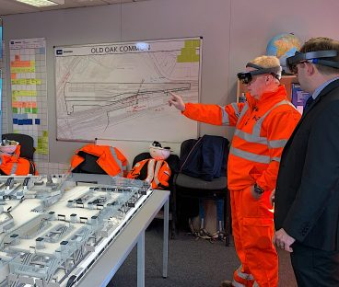
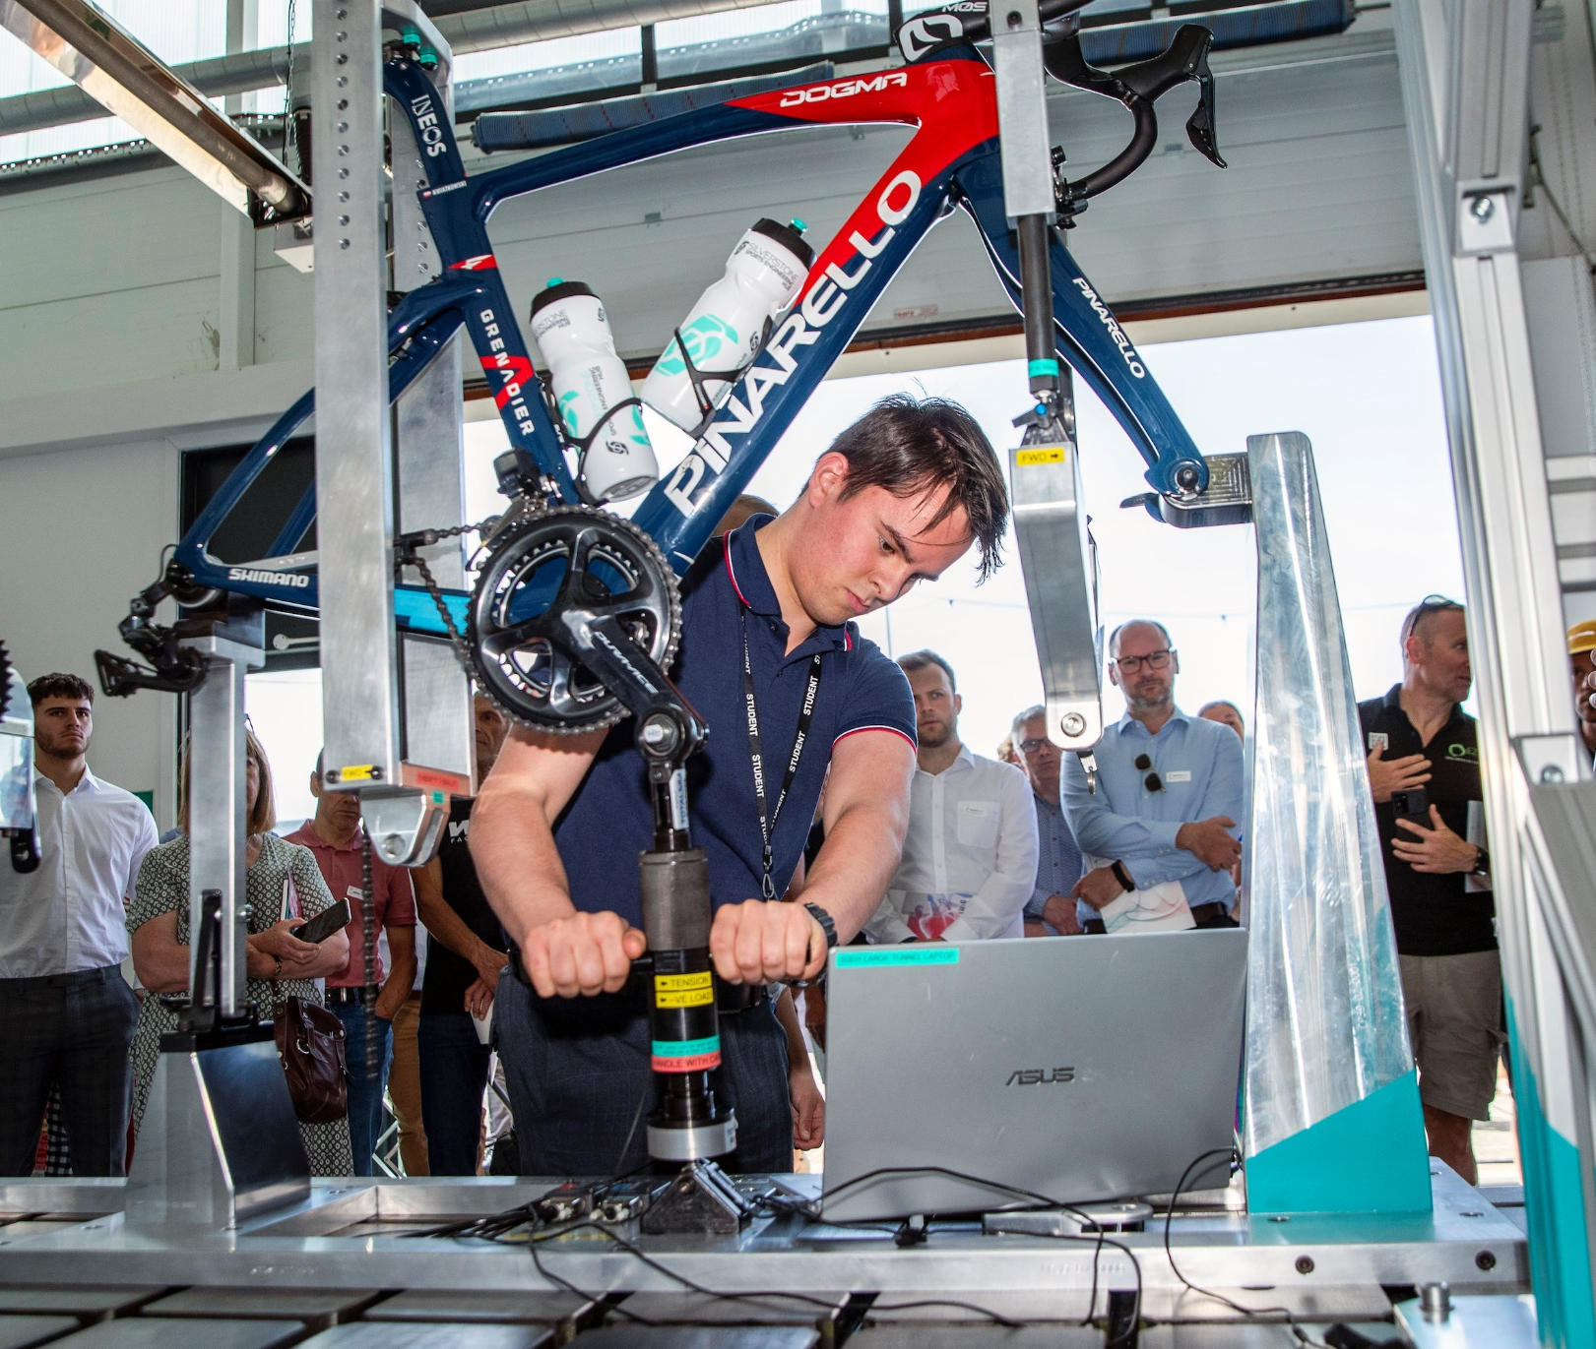
Establishing priorities
Criteria
Priority sectors will be established by mapping sectors in the following way:
Sectors which account for most employment (past 5 years)
Sectors with the highest levels of employment growth (past 5 years)
Sectors with the highest numbers of new entrants required e.g. those related to major infrastructure projects in the County
Growth sector priorities identified by local stakeholders e.g. through:
Local Industrial Strategy (BLEP 2019),
Strategic Economic Plan,
Recovery and Growth Proposal (Buckinghamshire Council 2022) or Levelling Up Plans
The Steering Group will also consider:
Cross-cutting skills needs e.g. soft skills, IT and digital skills and customer-related skills
Cross-sectoral developments, in particular the drive for sustainability, ‘net zero’ and digitalization .

Slide 9
Establishing priorities
Issues for consideration
We cannot do everything!
Focus on the areas where biggest impact can be made
Not all labour shortages are caused by shortcomings in post-16 technical education and training in Buckinghamshire
How the LSIP relates to other initiatives such as Levelling Up – Opportunity Bucks
Developing learner demand as well as understanding employer skills needs – but LSIP is not a schools initiative

Slide 10
Findings – emerging priorities
Sectors
Cross-sector themes
Engineering
Construction
Film & TV
Digital skills
Green skills
Work readiness

Slide 11
Findings – emerging priorities
Sectors
Cross-sector themes
Engineering
Construction
Film & TV
Digital skills
Green skills
Work readiness

Slide 12
LSIP Project Plan
September 2022
October 2022
Autumn 2022 – March 2023
Designation of ERB
3rd Oct submission of project plan and funding application
Develop LSIP with stakeholders, employers and providers
Draft priorities to training providers – end March
May 2023
LSIP submitted to DfE by 31 May 2023 for approval by Sec of State
Once approved published by DfE
Providers and stakeholders action priorities in LSIP
November 2022
Recruitment
Project planning
Provider network start up
Stakeholder and employer comms initiated
Sector groups formed
Stakeholder engagement
Priorities discussed
Mapping of existing research
New staff start to be engaged
Approval of Project Plan by DfE
Priorities identified and further discussed and agreed?
Research undertaken
Sector groups fully engaged
Training provider group fully engaged
Cycle of review and update until next LSIP

