Slide 2
Job Vacancies within Buckinghamshire
January 2021

Slide 3
Background
This slide deck provides a monthly summary of recruitment trends within Buckinghamshire.
Data is sourced from Burning Glass Technologies via the Labour Insight platform. Data is generated by scraping information from job adverts posted on-line Further details can be found here.
To monitor the impact of Covid-19 on the labour market, and track the speed of economic recovery, data within this report is either benchmarked against Quarter 1 (January to March) 2020, or is benchmarked against the corresponding month in 2019.
Further details, including some caveats to be aware are, can be found at the end of this slide deck.

Slide 4
Monthly Job Postings – 2020

Slide 5
Monthly Job Postings – 2020
As with the national picture, job postings in Buckinghamshire declined significantly at the start of the first Covid-19 lockdown.
From May to October 2020, the number of job postings (nationally and in Buckinghamshire) rose month on month.
In October, the number of job postings returned to pre-pandemic levels.
The second national lockdown initiated in early November brought a return to falling job posting numbers, however they remained at pre-pandemic levels in Buckinghamshire.
December saw a drop in job posting numbers in Buckinghamshire, whereas numbers for England remained relatively level. This is to be expected as recruitment activity tends to be lower in December.

Slide 6
Recruitment activity tends to vary across the year, so how does 2020 compare with 2019 on a month-by-month basis?
Data for Buckinghamshire

Slide 7
Variation within Buckinghamshire
Job postings in Buckinghamshire are lower overall compared to last year, however job postings in Chiltern and Aylesbury Vale are higher compared to last year.
In the case of Aylesbury Vale, this could be related to the presence of large public sector employers.
Within Buckinghamshire, Wycombe has had the largest fall in the number of job postings.
Buckinghamshire’s decline in job postings is lower compared to declines for the South East region and England as a whole
Note – some job postings state the job location as being ‘Buckinghamshire’ only. These cannot therefore be coded to sub-areas. Hence why the data for Buckinghamshire is higher than the data for the four former districts combined.
 | Number of job postings
 | Mar-Dec 2019 | Mar-Dec 2020 | Change | Change (%)
Wycombe | 14,670 | 12,390 | -2,280 | -16%
Aylesbury Vale | 9,250 | 9,450 | +200 | +2%
South Bucks | 2,970 | 2,800 | -170 | -6%
Chiltern | 2,970 | 3,100 | +130 | +4%
Buckinghamshire | 42,540 | 38,580 | -3,960 | -9%
South East England | 887,710 | 753,080 | -134,630 | -15%
England | 4,429,700 | 3,856,530 | -573,170 | -13%

Slide 8
Top occupational groups by number of job postings – December 2020
Data for Buckinghamshire

Slide 9
Job creation: occupations with more job postings in Bucks in Q4 2020 than Q4 2019
Health and social care roles (care in particular)
Roles linked to increase in online retail (warehouse and driver roles)
Teaching roles
Legal and finance roles
Some construction roles
Source: Labour Insight

Slide 10
Reduced demand: occupations with fewer job postings in Bucks in Q4 2020 than Q4 2019
Hospitality (chefs, food service, waiting staff, housekeeping)
HR / recruitment
Computer (IT support, programmers, analysts)
Office admin
Sales and marketing
Source: Labour Insight

Slide 11
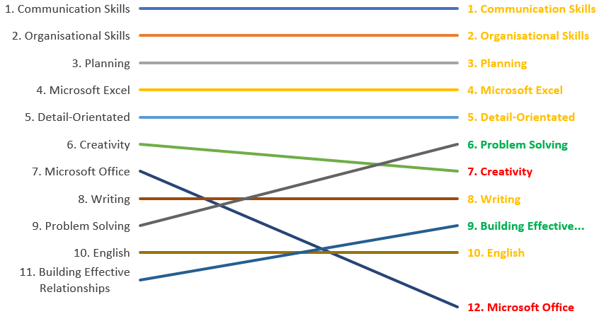
Changing demand for skills – baseline skills
The chart shows the change in demand for the top baseline skills (as cited within job postings) between Quarter 1 (Jan-Mar) and Quarter 4 (Oct-Dec).
Overall, there hasn’t been a great deal of change.
There has been a relative increase in demand for ‘problem solving’ skills (9th to 6th), and ‘building effective relationships’ skills (11th to 9th)
And a relative decrease in demand for ‘creativity’ (6th to 7th), and skills in ‘Microsoft Office’ (7th to 12th).
Q1
Q4

Slide 12
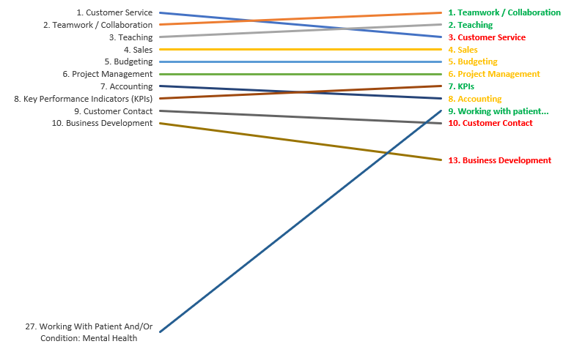
Changing demand for skills – specialist skills
The chart shows the change in demand for the top specialised skills demand (as cited within job postings) between Quarter 1 (Jan-Mar) and Quarter 4 (Oct-Dec).
There was a significant increase in demand for ‘working with patient and/or condition: mental health’ (27th to 9th).
Demand also increased for ‘teamwork / collaboration (2nd to 1st), ‘teaching’ (3rd to 2nd) and ‘KPIs (8th to 7th).
There were declines in demand for ‘customer service’ (1st to 3rd), ‘customer contact’ (9th to 10th) and ‘business development’ (10th to 13th) skills.
Q1
Q4

Slide 13
Demand for computer and programming skills
This table shows the top computer and programming skills featured in job postings for Buckinghamshire for the month of December 2020.
Four Microsoft Office suite programmes feature in the top five.
Demand for enterprise software SAP skills are growing both nationally and globally.
Microsoft Excel skills are projected to grow nationally, along with Customer Relationship Management (CRM) skills.
Skills for programming language Microsoft C# are declining, both nationally and globally.
Most sought computer and programming skills by Bucks employers | National Growth Category | Global Growth Category
Microsoft Excel | Growing | Stable
Microsoft Office | Stable | Stable
Microsoft PowerPoint | Stable | Stable
SQL | Stable | Stable
Microsoft Word | Stable | Stable
Microsoft C# | Declining | Declining
SAP | Growing | Growing
Enterprise Resource Planning (ERP) | Stable | Stable
Customer Relationship Management (CRM) | Growing | Stable
Software Development | Stable | Stable

Slide 14
Some employers with the most job openings in Buckinghamshire – October to December 2020
Around 45% of job postings in Buckinghamshire can be linked to a specific employer. Many employers chose not to provide their name when recruiting via a recruitment agency or job site.
This table is therefore based on the 45% of job postings which can be linked to an employer (‘visible’ employers)
‘Visible’ employers with the most job openings for the last full quarter (Q4 Oct-Dec) are primarily in the Human Health and Social Work sector.
This corresponds with the high proportionate number of job postings for the sector.
Source: Burning Glass Technologies
Note: 55% of records have been excluded because they do not include an employer. As a result, the chart above may not be representative of the full sample.

Slide 15
About the data
Online job postings provide a useful, real-time indication of the characteristics and health of local labour markets.
However, limitations of online job posting data include:
Some jobs not commonly advertised online (e.g. those often filled through word-of-mouth or adverts in windows)
The employer’s name often not being included in the job posting, which makes it difficult to glean a complete picture of the top recruiting employers in an area, and makes it difficult to assign jobs to industries.
The location not being provided in the job posting, in part due to the increased prevalence of remote working.
Burning Glass Technologies’ classifications of skills are:
Specialised skills - covers skills that are specific to an occupation, such as ‘lesson planning’ for teachers, or ‘Primary Care’ for nurses.
Baseline skills - are sometimes also called “soft skills” or “transferable skills”. They include skills that are useful across a variety of occupations, such as ‘research’ or ‘staff coordination’.
Computer and programming skills - are IT skills ranging from widely applicable (e.g. ‘Microsoft Word’) to highly specialised (e.g. ‘PERL’).

